Slide 1

Capstone Project - Car accident severity

Slide 2






Importance of this study
It is estimated that road traffic accidents cost the United States economy arround $810 billion per year, including costs due to property and vehicular damage, legal costs, medical bills and loss of earnings.

Slide 3




Importance of this study
It´s important to understand the factors influencing the severity of road traffic accidents, in order people and the government can devise strategies to mitigate accident severity, and in order to decrease the incidence of accidents and potentially save lives.

Slide 4


Data Acquisition and Cleaning
194673
Car accidents
Kinds of different features
38

Slide 5





Data Acquisition and Cleaning
Vehicle count
Road Conditions
Weather
We will work with five of the most important features in this study and one predicted lable
Accident severity
Light Conditions
Collision Type

Slide 6
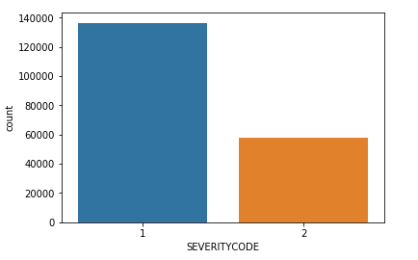
Sevrity count
1 means property damage
2 means injury

Slide 7
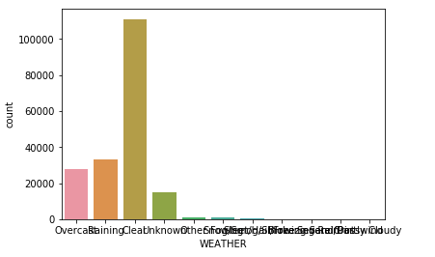
Weather Conditions
Most accidents occurred during clear skys, raining and overcast.

Slide 8
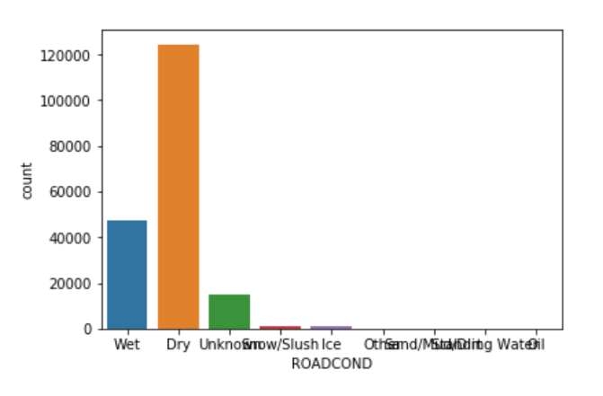
Road Conditions
Most accidents occurred during dry and wet roads.

Slide 9
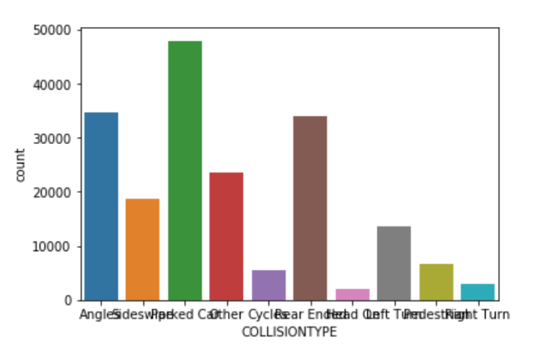
Collision Type
Most accidents occurred were angles, side crash, and rear ended.

Slide 10
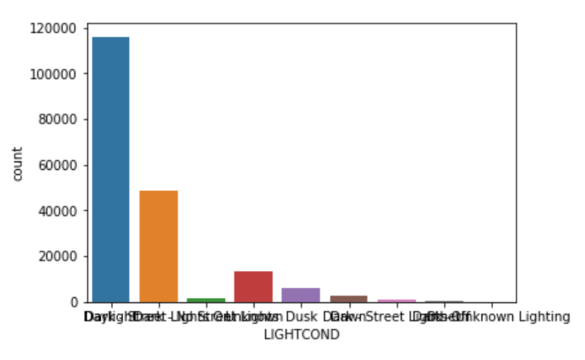
Light conditions
Most accidents occurred by day, night and dusk.

Slide 11
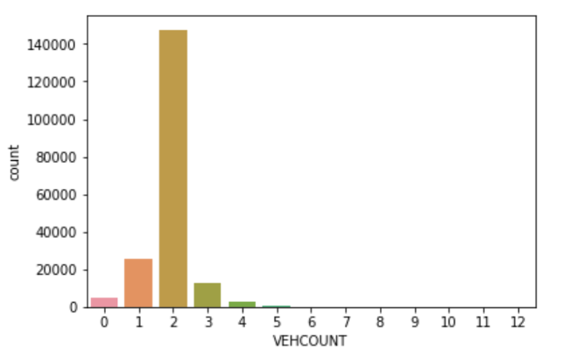
Vehicle count
Most accidents envolved two, one or three cars.

Slide 12
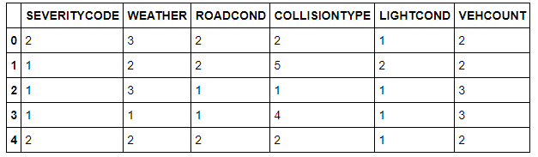
The data frame

Slide 13
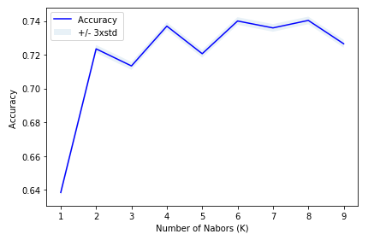
Classification Model

Slide 14
Classification Model
Method | Accurancy | Jaccard Score | F-1 Score
KNN | 0,74 | 0,74 | 0,70
Decision Tree | 0,75 | 0,75 | 0,71
SVM | 0,75 | 0,75 | 0,71
Log Reg | 0,72 | 0,72 | 0,66

Slide 15
Discussion
As we can see the model preforms best at K=8. And, we also can affirm, based on the classification model table, that both decision tree and SVM (support vector machine) preform well, with an accuracy over 75%. Although, decision tree had a much faster processing time, making it the best choice to use in this study.

Slide 16
Conclusion
This study allowed important insights to be taken, based on the data and factors analyzed. With the factors considered it is evident the importance of the care that the city must take in correctly signaling streets and avenues, ensuring adequate lighting and encouraging drivers to pay attention to conditions climate change.

